Slide 1
FILM STUDIES Analyzing the art of film

Slide 2




A VARIED OBJECT OF STUDY
Science: film technology, cognitive reception studies
Economics: the movies, production process, industry studies
Politics: historical artifact, ideological analysis
Aesthetics: cinematic form, auteur style, genre studies

Slide 3
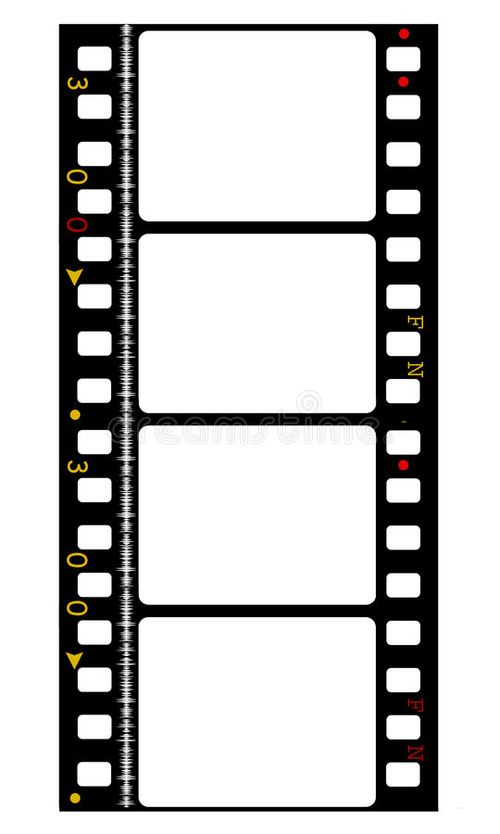
FILM: strips of perforated celluloid
Acetate base (shiny side) with an emulsion, light sensitive layers of gelatin (silver halide)
Sprockets and sprocket hole perforations
Soundtrack (magnetic, optical)

Slide 4
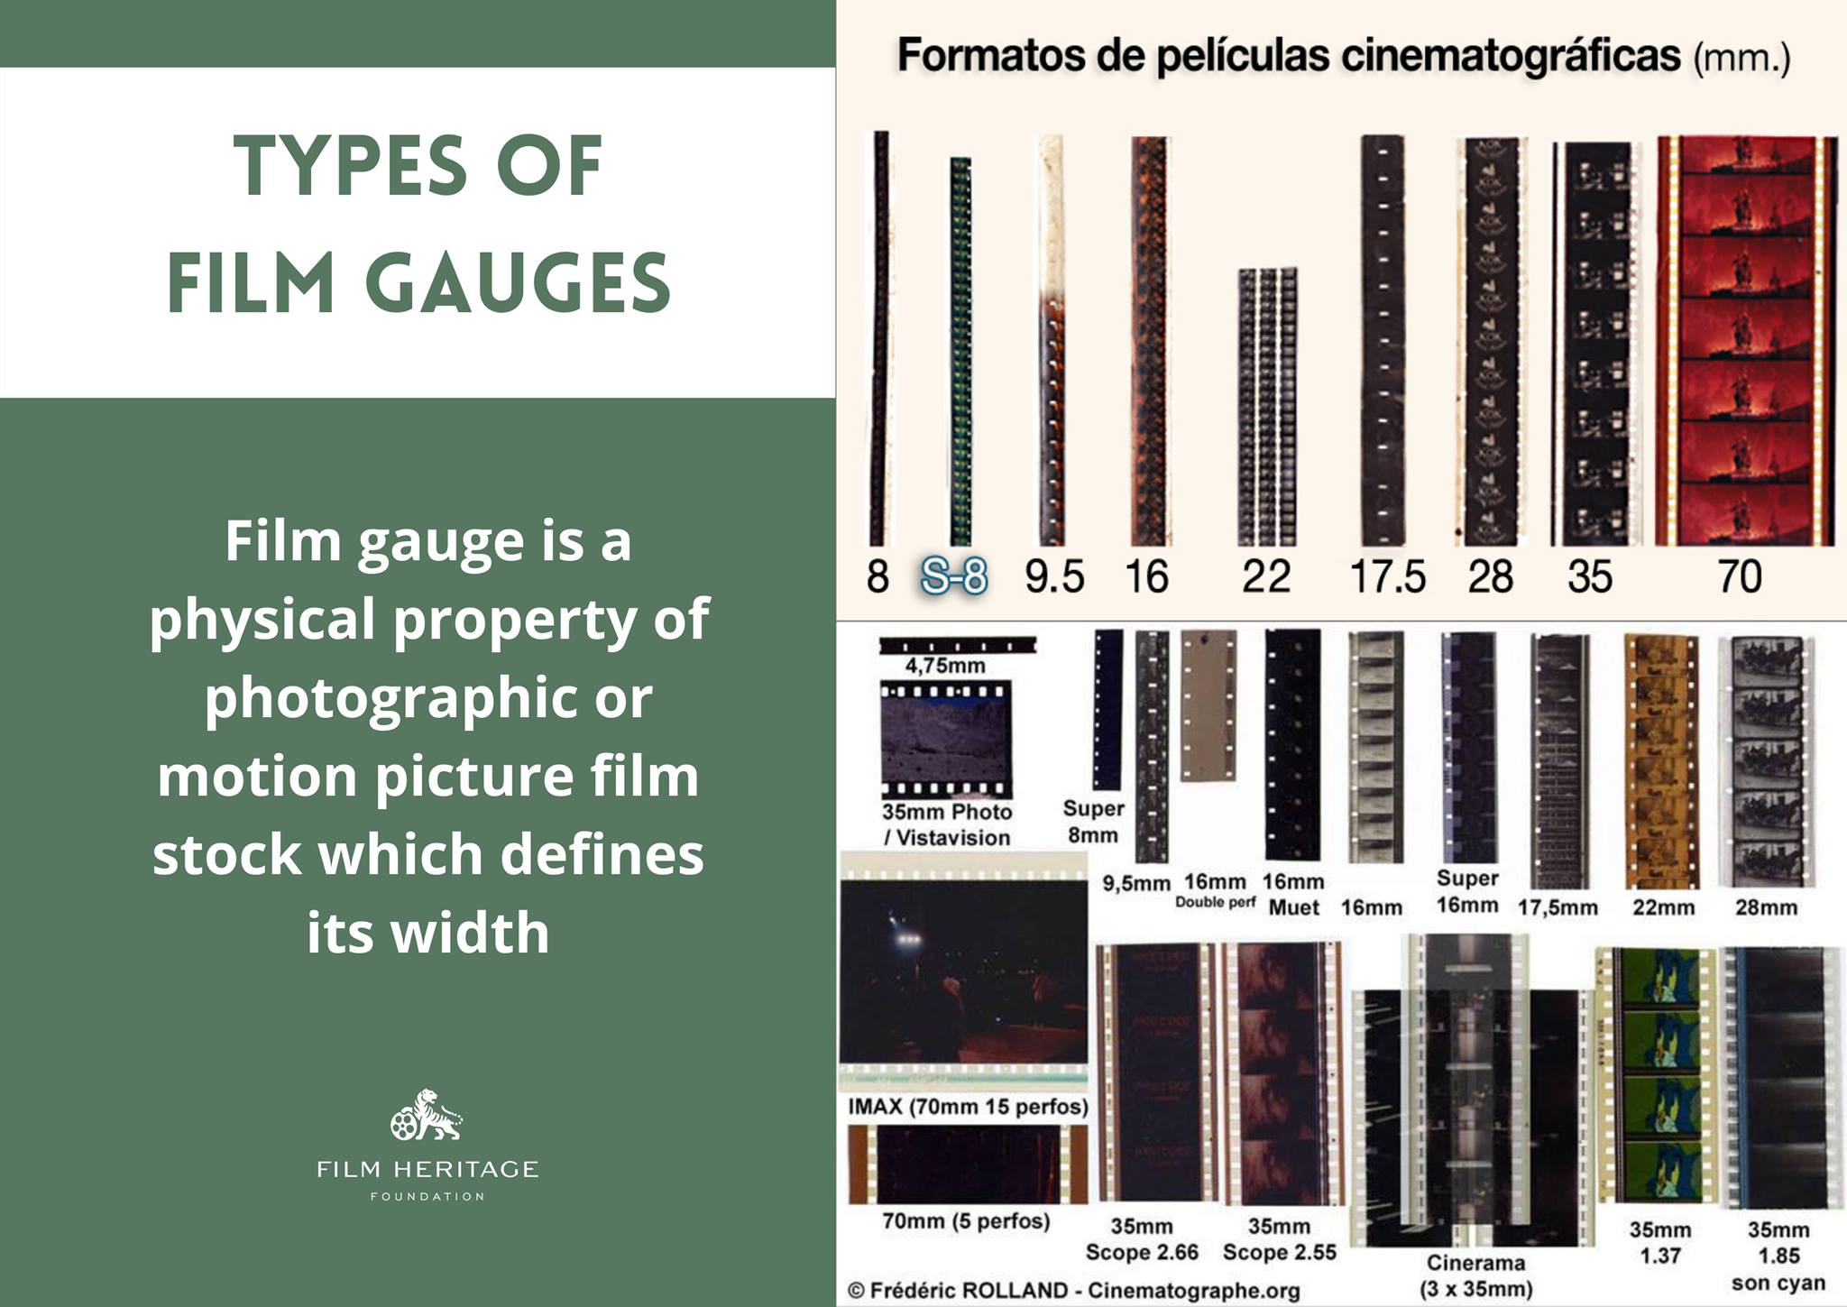

Slide 5
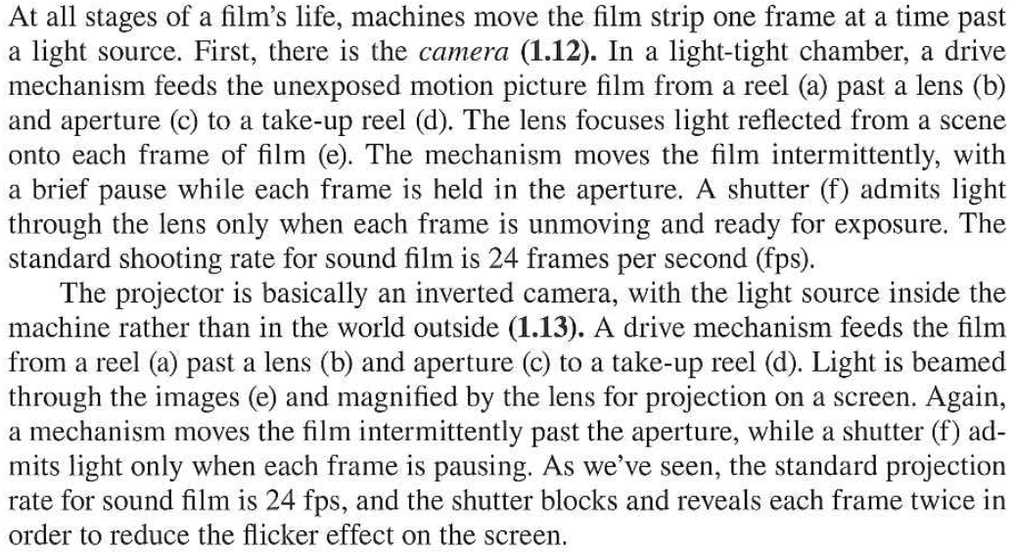
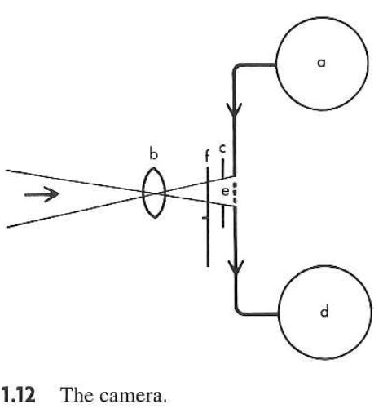
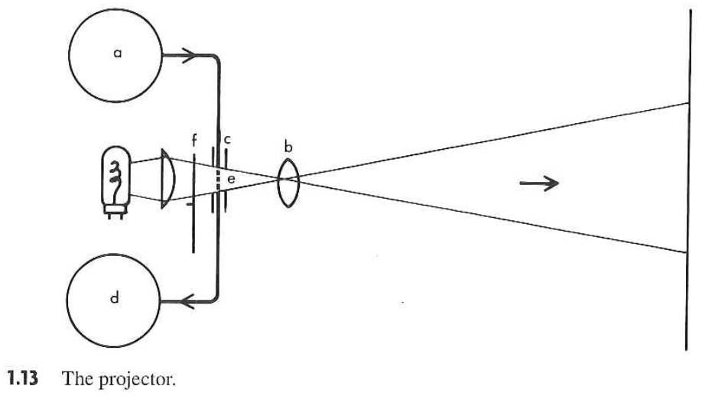

Slide 6
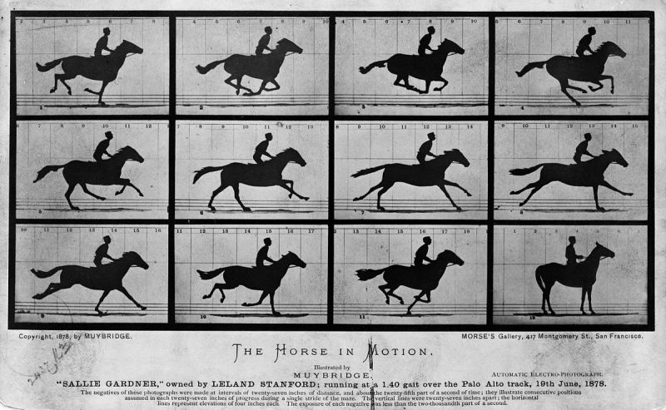
Critical Flicker Fusion and Apparent Motion

Slide 7
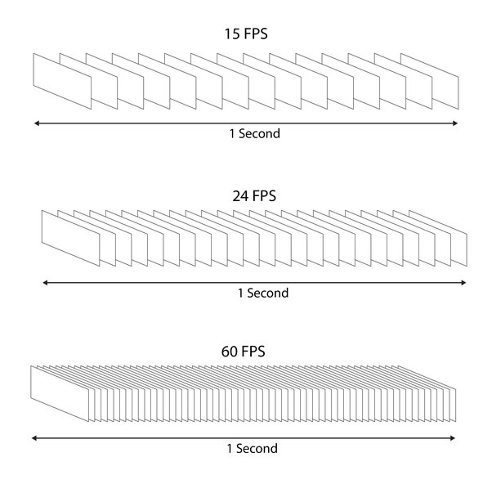
Standard:
24 still frames per second, which projector’s shutter speed breaks into 48 flashes to meet critical flicker fusion threshold (for humans)

Slide 8
FILM PRODUCTION
Production Distribution Exhibition
Pre-production Production Post-Production
Scriptwriting and funding
Preparation for filming (planning the physical production)
Shooting (create film’s images and sounds)
Assembly (images and sound combined through editing, special effects, music, titles, and extra dialogue added)

Slide 9
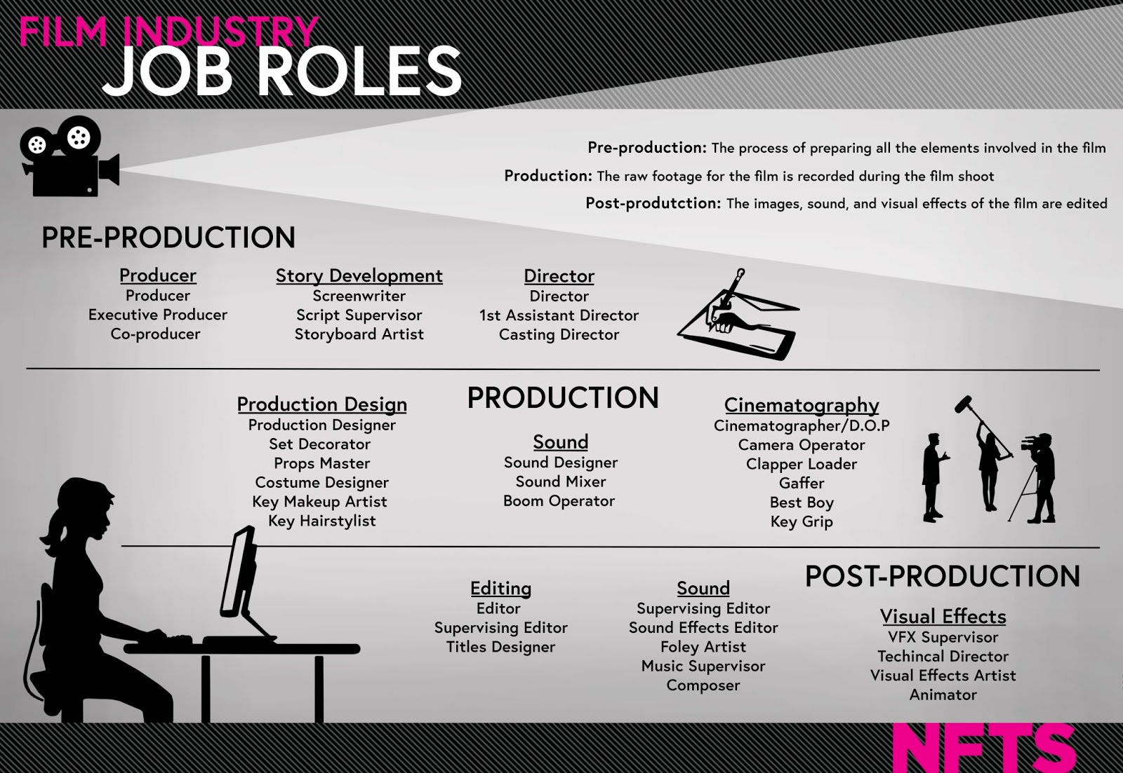

Slide 10
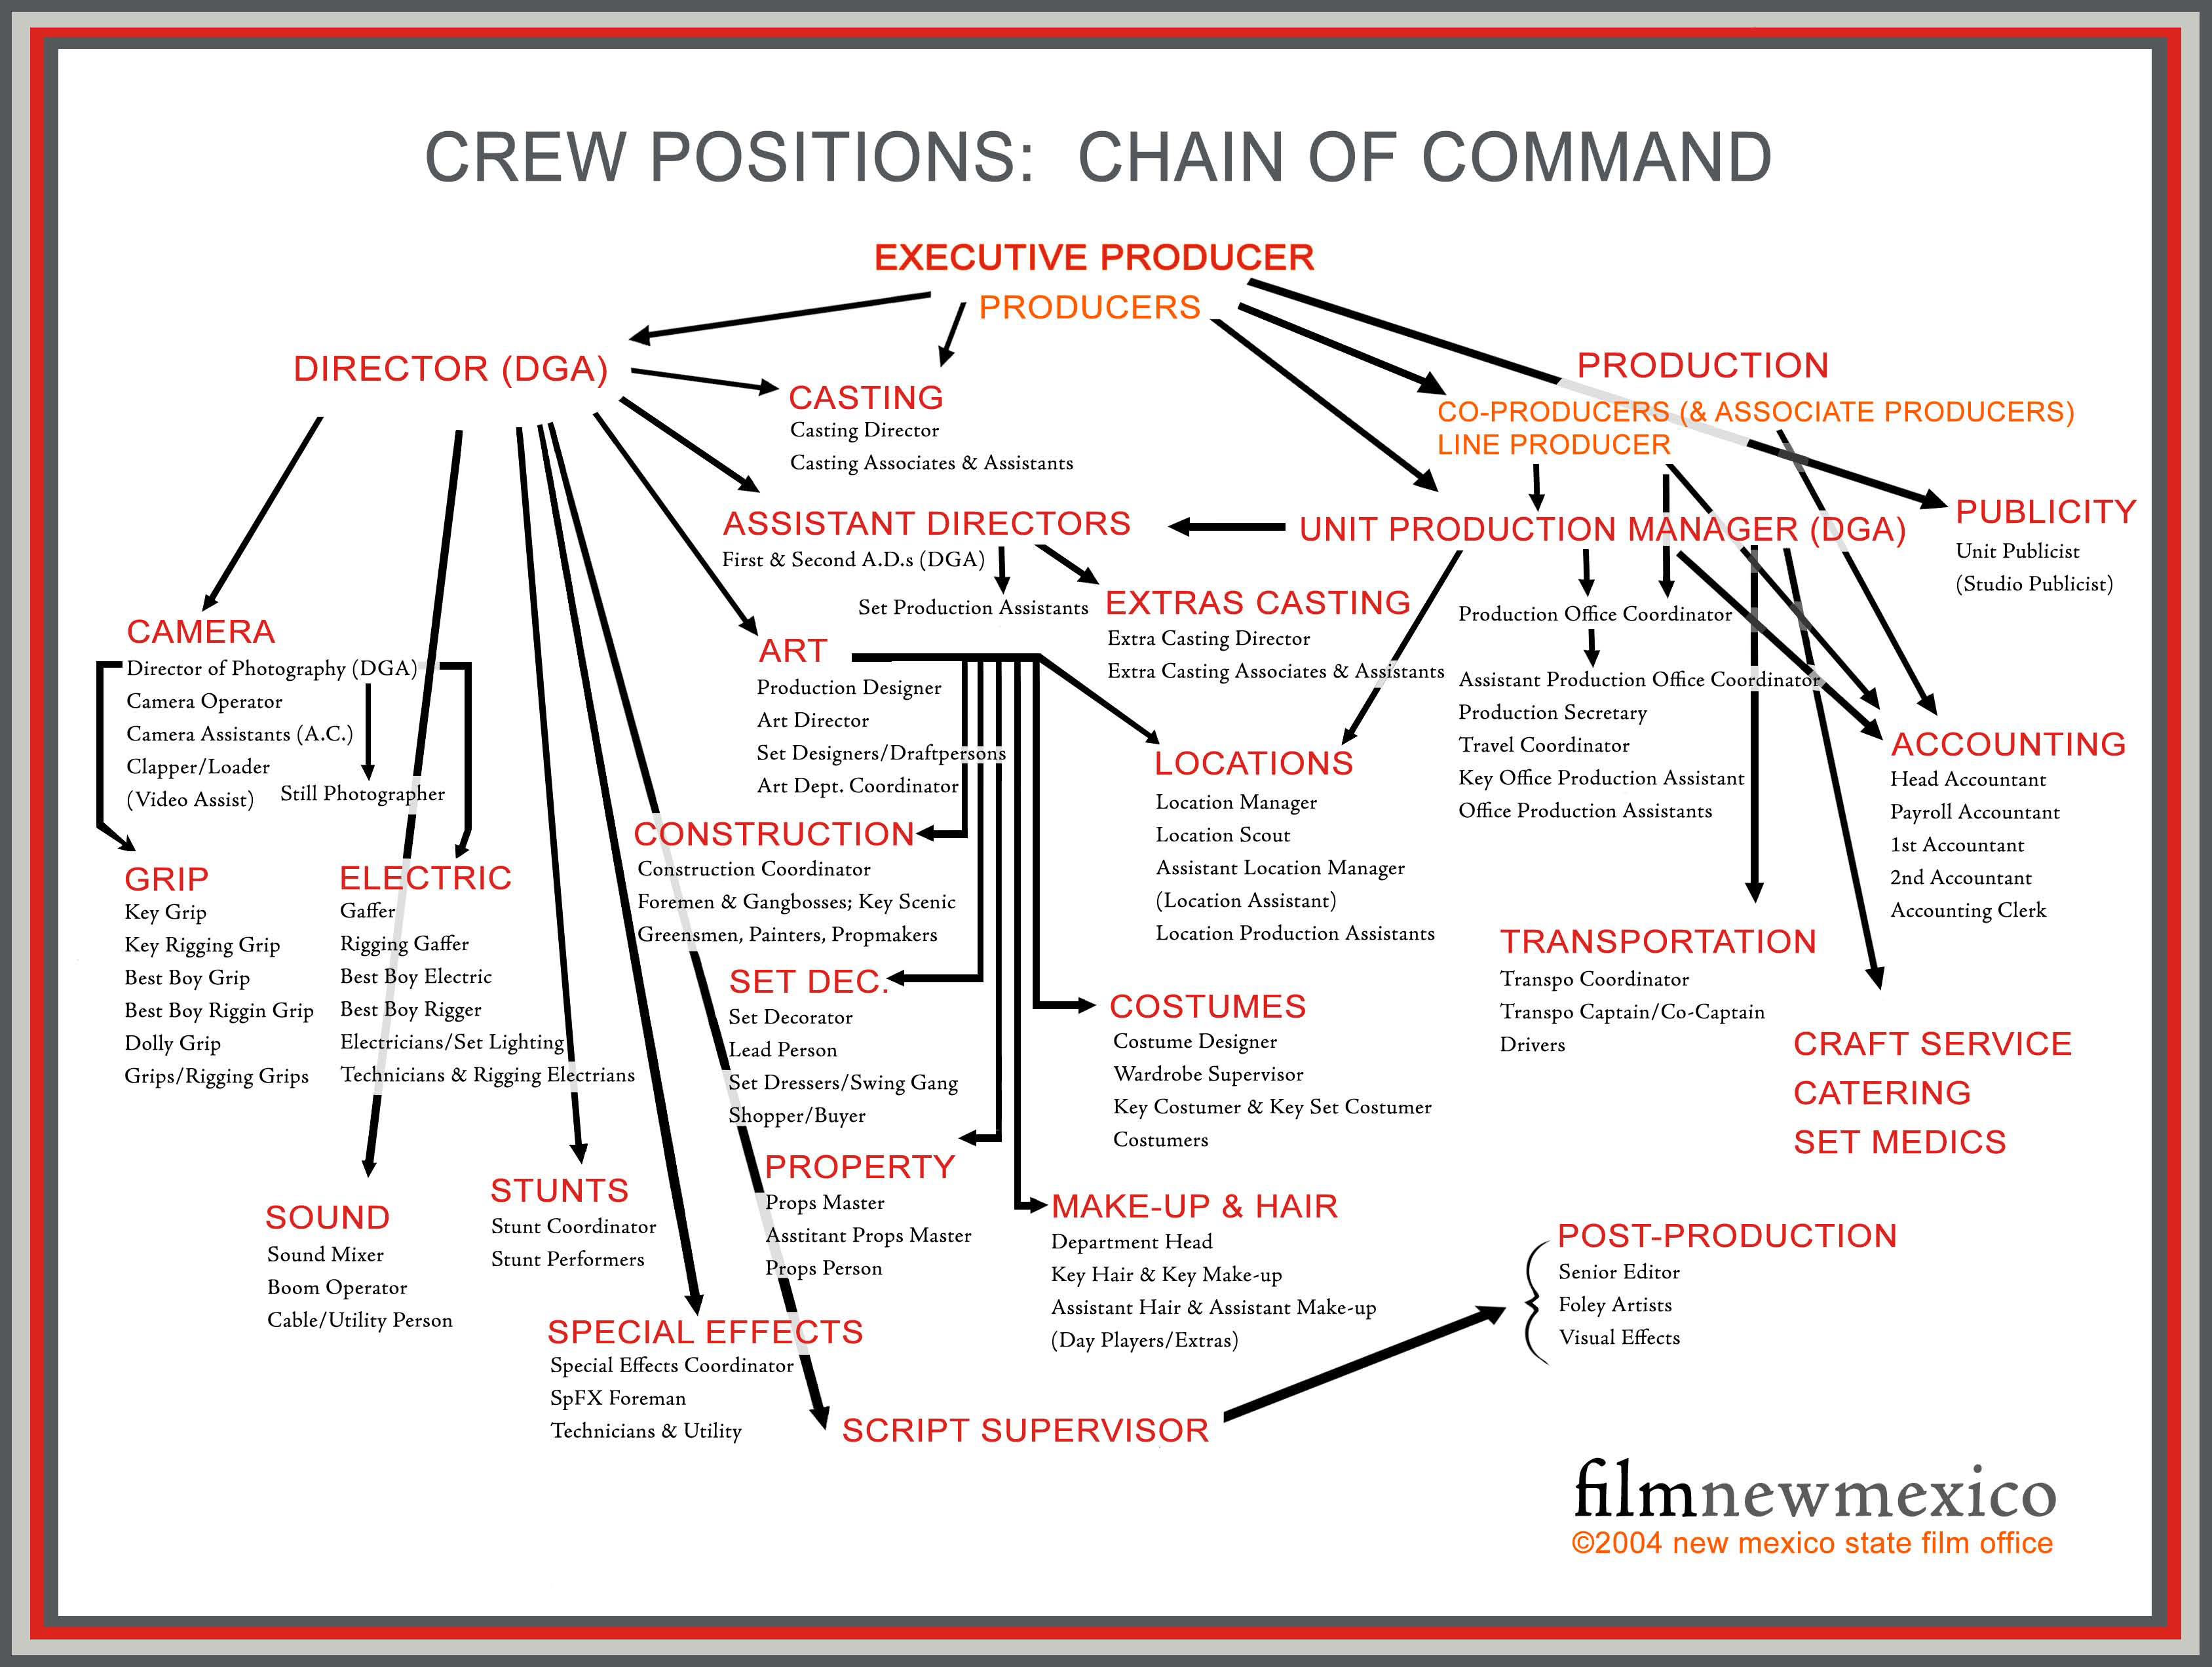

Slide 11
4 ASPECTS of FILM FORM
Mise-en-scene: arrangement of all elements onscreen
Cinematography: process of capturing moving images on film
Editing: piecing together of individual shots
Sound: voices, effects, & music

Slide 12
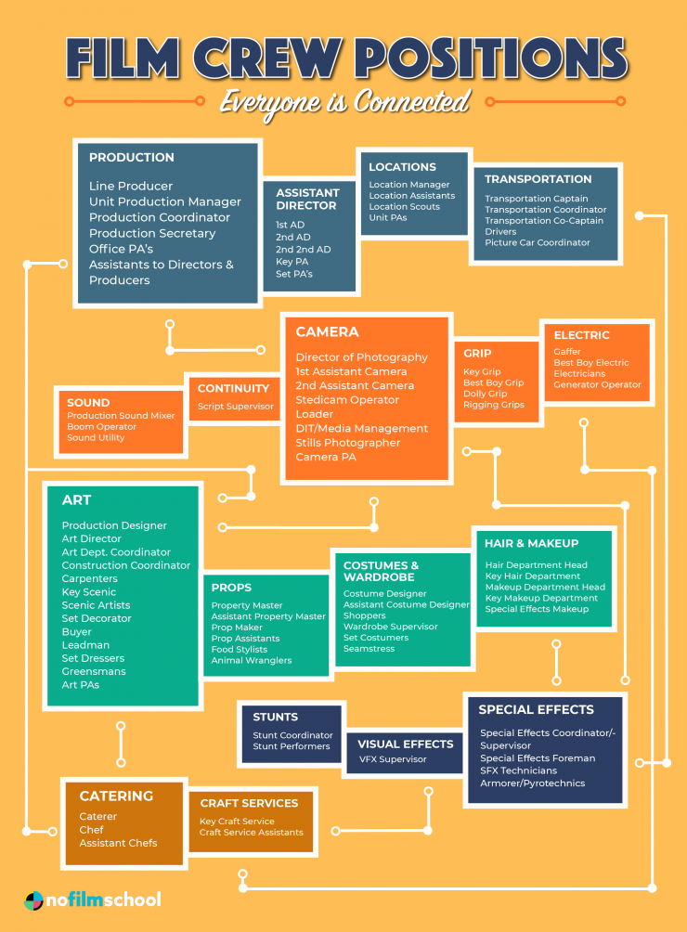
Mise-en-scène
French: that which has been put into the scene or put onstage
all the elements placed in front of the camera to be photographed
Expressive totality of single film image

Slide 13
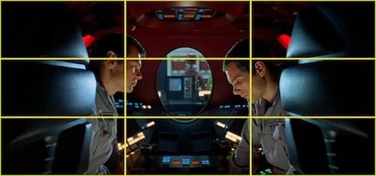
RULE OF THIRDS

Slide 14
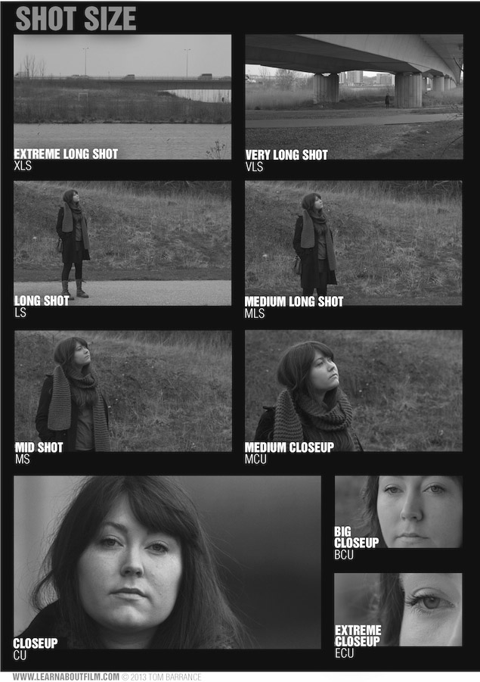
SHOT:
basic building block of filmmaking; a piece of film run through the camera, exposed, and developed; one uninterrupted run of the camera, which can be short or long; a minimal unit of dramatic material

Slide 15
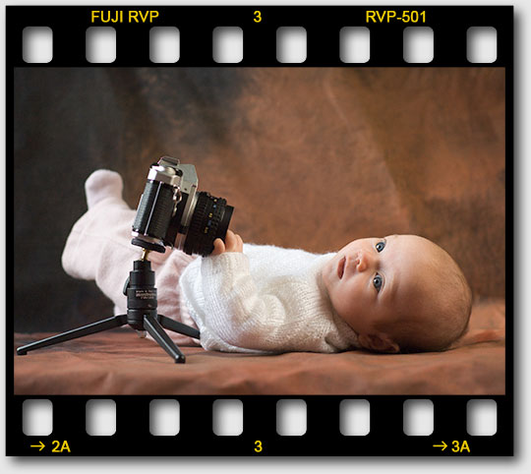
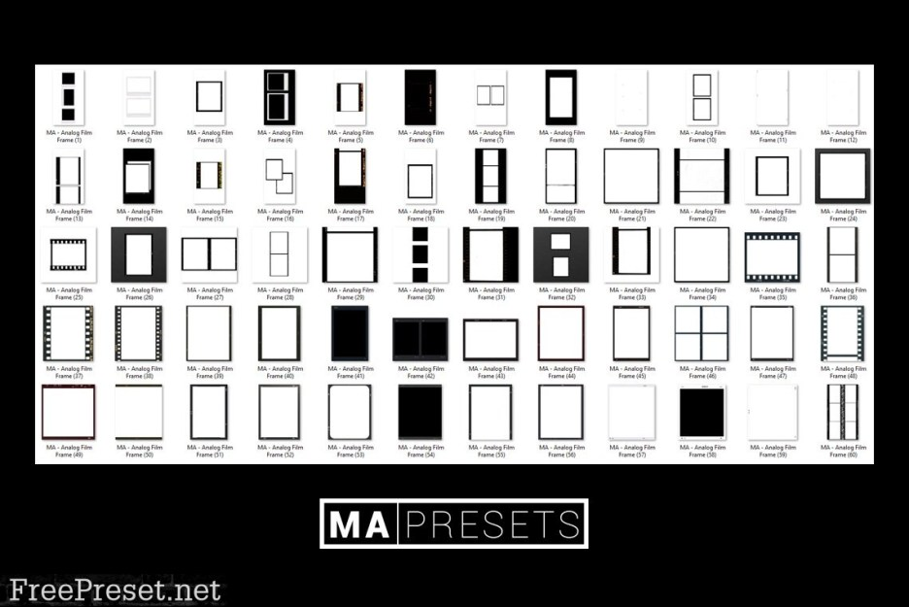
FRAME:
Single image of film;
also borders of the image
on screen
(like a picture frame)
FRAMING ELEMENTS:
Distance of camera to subjects, scale of various objects in relation to each other, camera angle and height, depth of composition (layers), type of camera movement, mattes

Slide 16
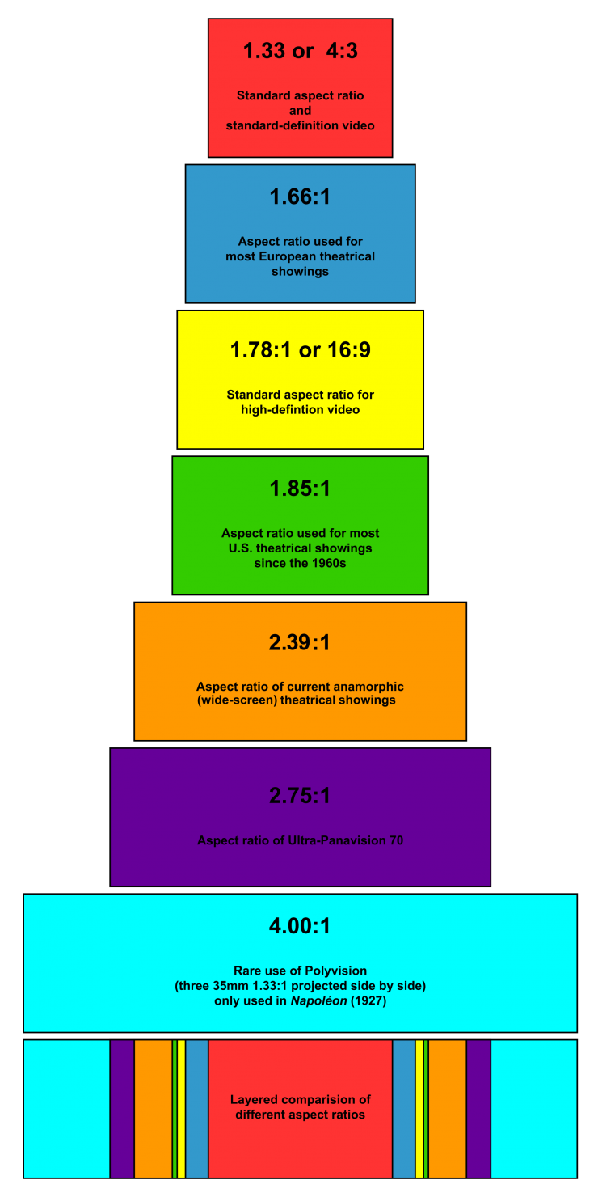
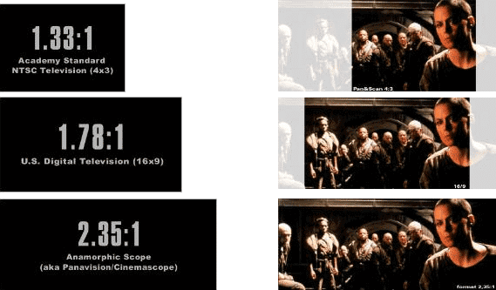
ASPECT RATIO

Slide 17
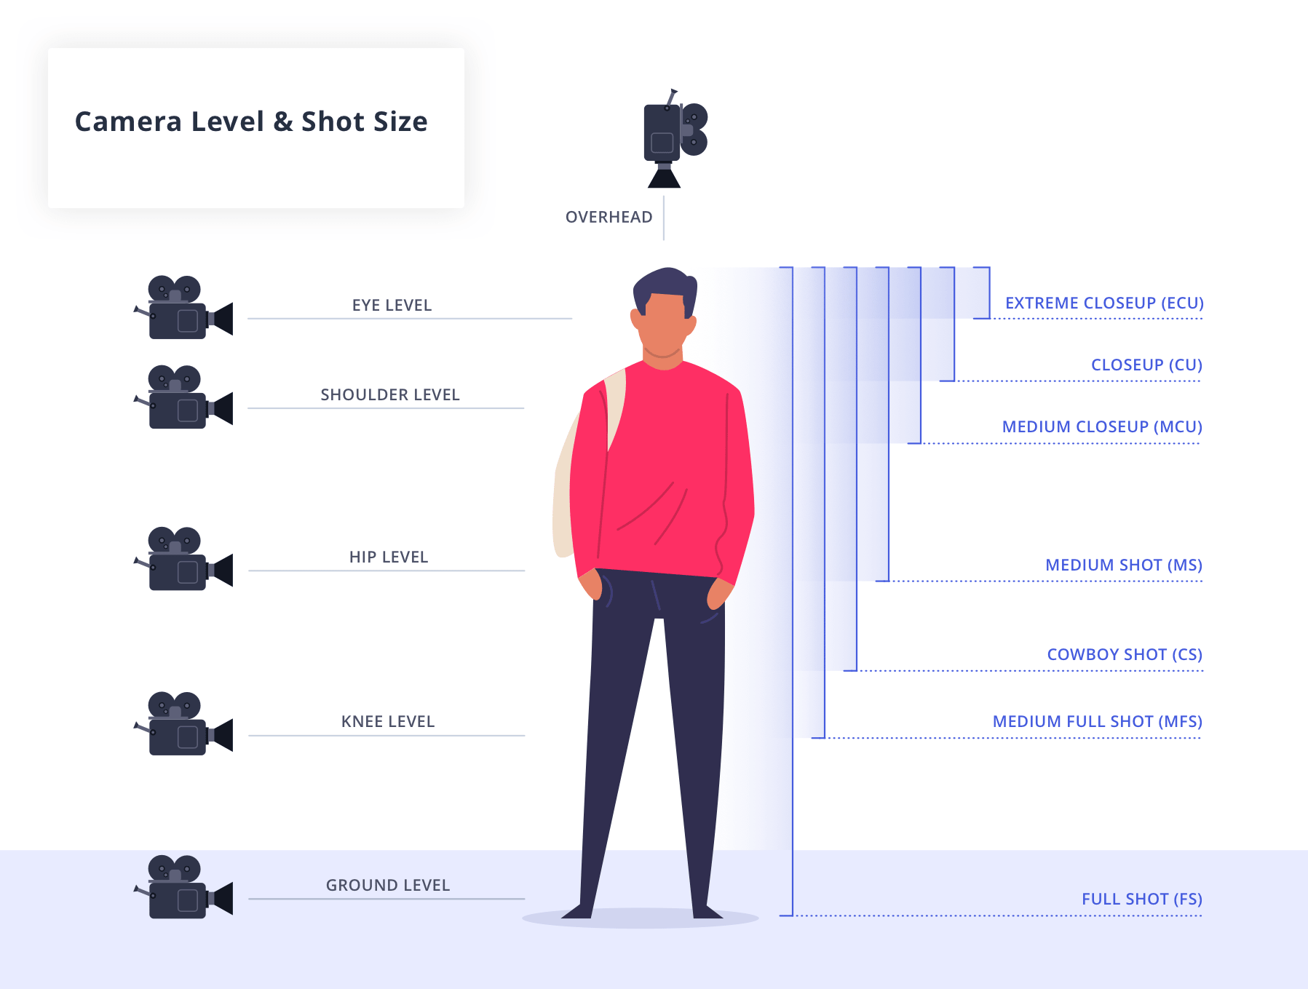

Slide 18
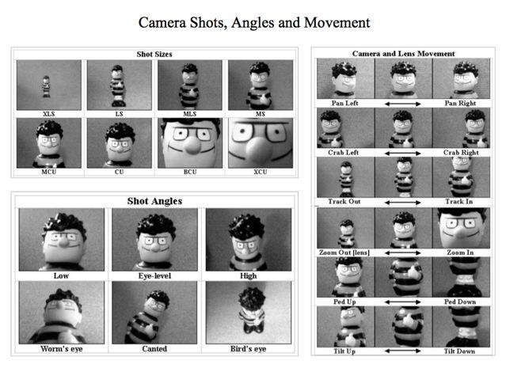

Slide 19
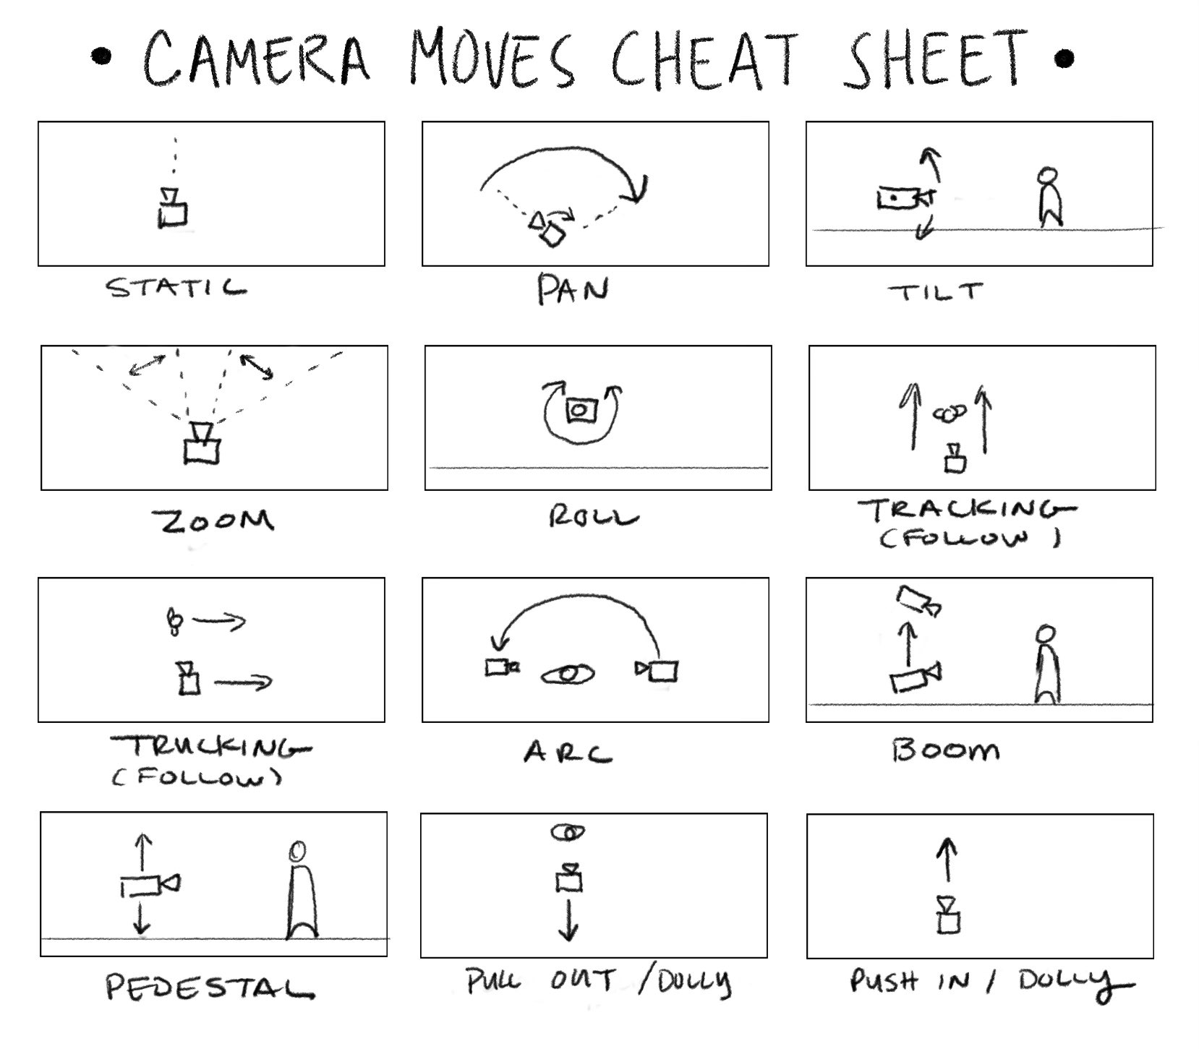

Slide 20
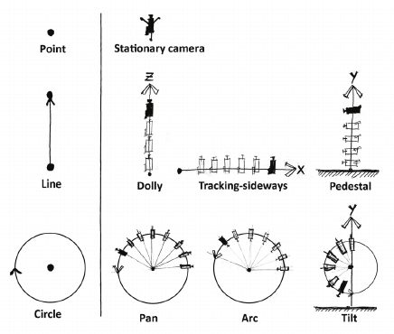
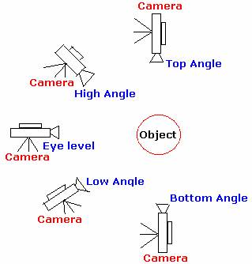
Dolly versus Zoom

Slide 21
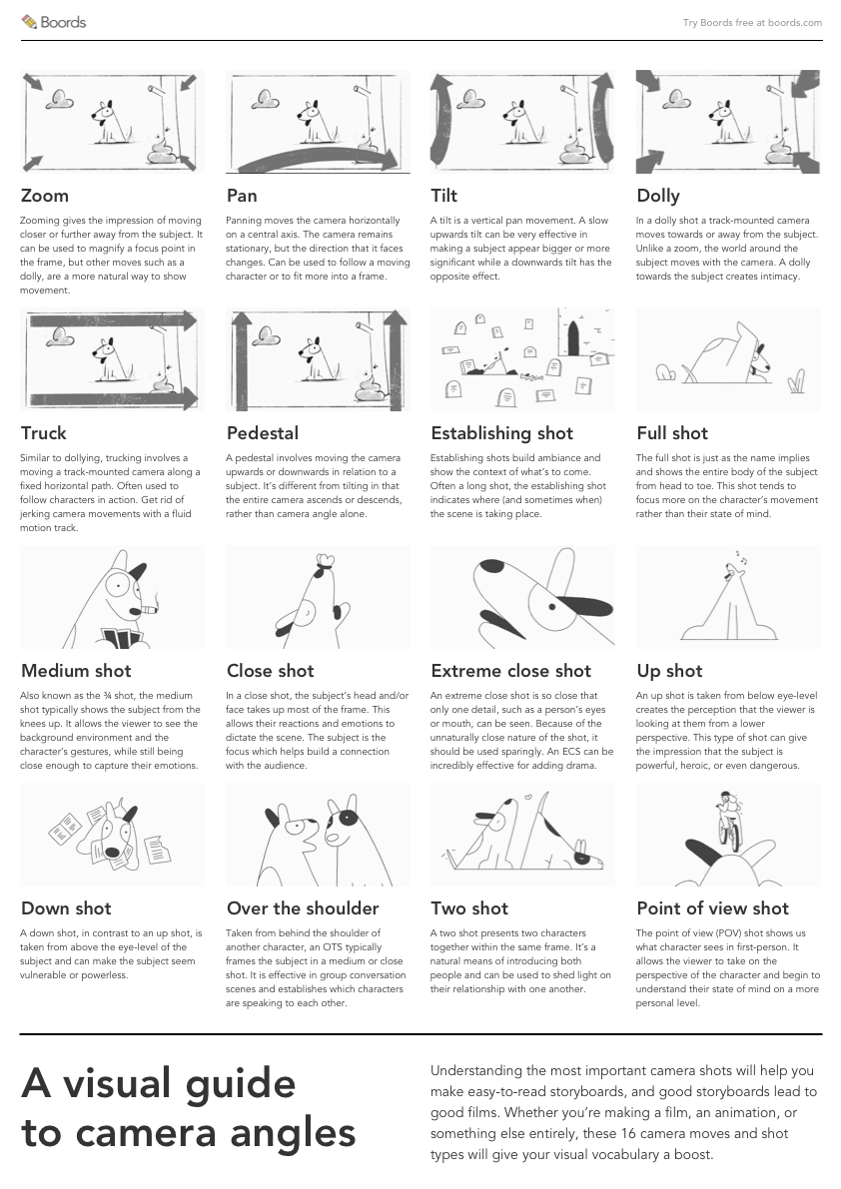
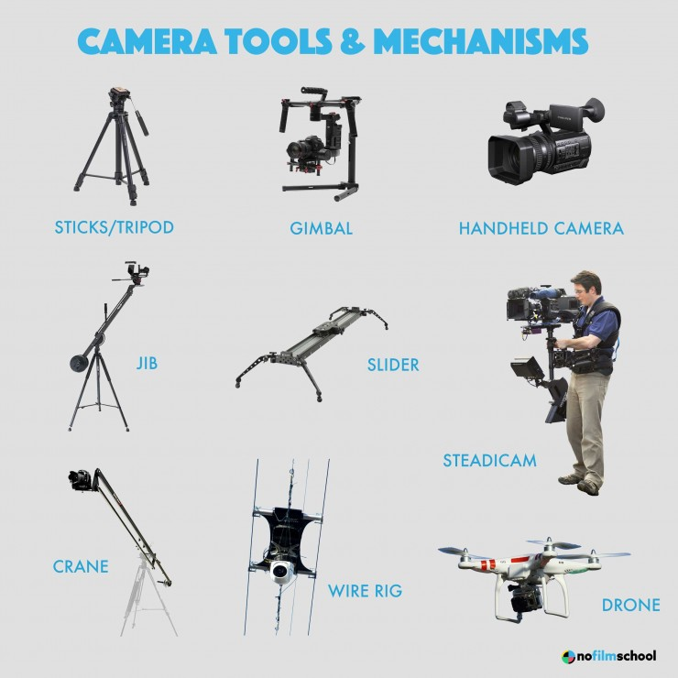
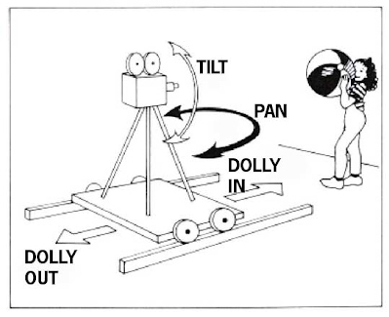

Slide 22
